Slide 1
MongoDB
Module1
Introduction for mongodb
Presentation by: Gopinath G

Slide 2
MongoDB: An introduction
MongoDB, the most popular NoSQL database, is an open-source document-oriented database. The term ‘NoSQL’ means ‘non-relational’. It means that MongoDB isn’t based on the table-like relational database structure but provides an altogether different mechanism for storage and retrieval of data. This format of storage is called BSON
( similar to JSON format).

Slide 3
MongoDB: Getting Started
Terminologies: A MongoDB Database can be called as the container for all the collections.
Collection is a bunch of MongoDB documents. It is similar to tables in RDBMS.
Document is made of fields. It is similar to a tuple in RDBMS, but it has dynamic schema here. Documents of the same collection need not have the same set of fields

Slide 4
What is MongoDB – Working and Features
MongoDB is an open-source document-oriented database that is designed to store a large scale of data and also allows you to work with that data very efficiently. It is categorized under the NoSQL (Not only SQL) database because the storage and retrieval of data in the MongoDB are not in the form of tables.
The MongoDB database is developed and managed by MongoDB.Inc under SSPL(Server Side Public License) and initially released in February 2009. It also provides official driver support for all the popular languages like C, C++, C#, and .Net, Go, Java, Node.js, Perl, PHP, Python, Motor, Ruby, Scala, Swift, Mongoid. So, that you can create an application using any of these languages.

Slide 5
How it works ?
Now, we will see how actually thing happens behind the scene. As we know that MongoDB is a database server and the data is stored in these databases. Or in other words, MongoDB environment gives you a server that you can start and then create multiple databases on it using MongoDB. Because of its NoSQL database, the data is stored in the collections and documents. Hence the database, collection, and documents are related to each other as shown below:

Slide 6
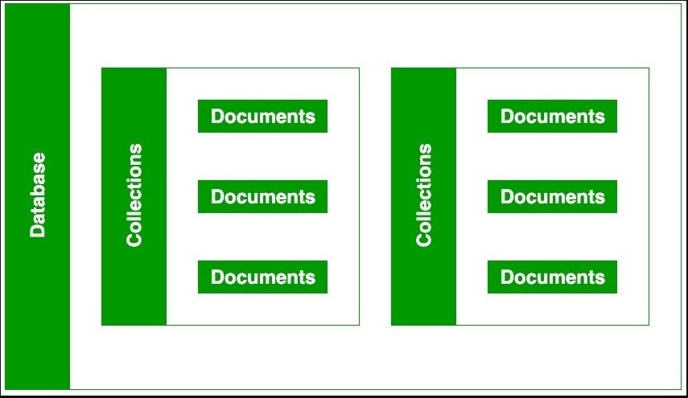
Pictorial representation

Slide 7
Advantages of MongoDB :
It is a schema-less NoSQL database. You need not to design the schema of the database when you are working with MongoDB.
It does not support join operation.
It provides great flexibility to the fields in the documents.
It contains heterogeneous data.
It provides high performance, availability, scalability.
It supports Geospatial efficiently.
It is a document oriented database and the data is stored in BSON documents.
It also supports multiple document ACID transition(string from MongoDB 4.0).
It does not require any SQL injection.
It is easily integrated with Big Data Hadoop
Disadvantages of MongoDB :
It uses high memory for data storage.
You are not allowed to store more than 16MB data in the documents.
The nesting of data in BSON is also limited you are not allowed to nest data more than 100 levels.

Slide 8
Thankyou..!

